Slide 1
Recitation 9
Mini Lecture

Slide 2
Announcements
Grades for Recitation 6, 7 and 8 are on Sakai (+Extra credit, 2.5pts)
No class and office hours on the week of Thanksgiving, Nov 22
Recitation 10 (Last Recitation class) – Nov 29 and Dec. 1.
Exam 2 – Recitation group 6 (Dec. 6th) and Recitation group 6 (Dec. 8th)
(No final exam)

Slide 3
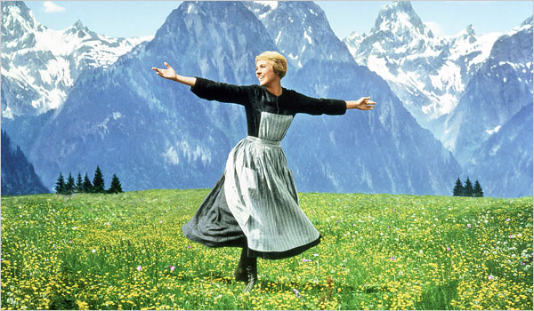
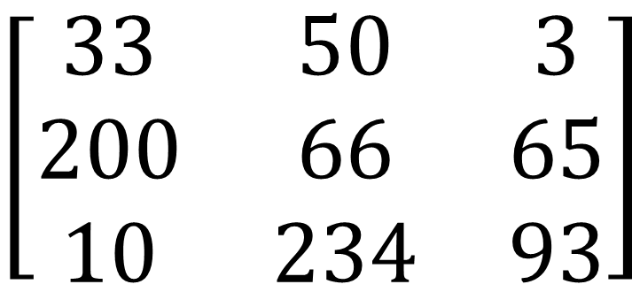
Images
Images
Black and white (grayscale) images are stored in a single matrix
In MATLAB, black and white image matrices are in the uint8 format
Each element is an 8 bit integer (can be between 0 and 255)
Represents greyscale value (0 = black, 255 = white) for a pixel
$$\left[\begin{matrix}33 & 50 & 3 \\ 200 & 66 & 65 \\ 10 & 234 & 93\end{matrix}\right]$$

Slide 4
Working with RGB Images
RGB Images
RGB images are stored in 3 matrices
A single m x n x 3 variable in MATLAB
Each matrix is the intensity of red, green or blue
Still uint8, 0 = no intensity, 255 = full intensity

Slide 5
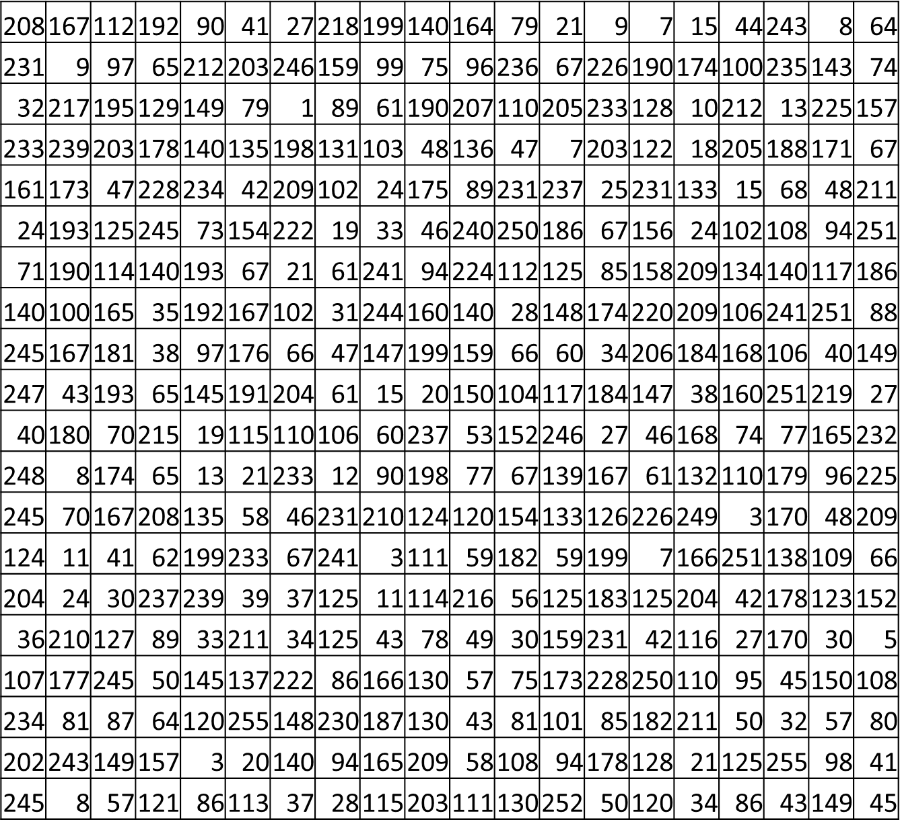
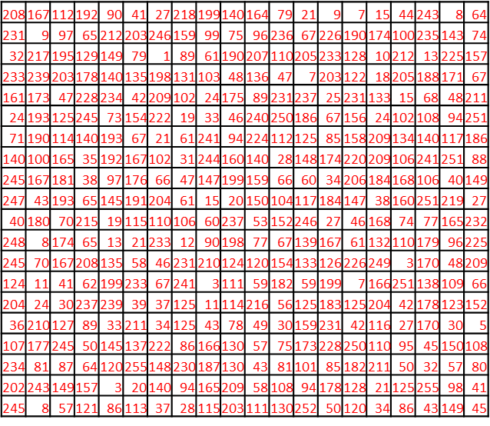
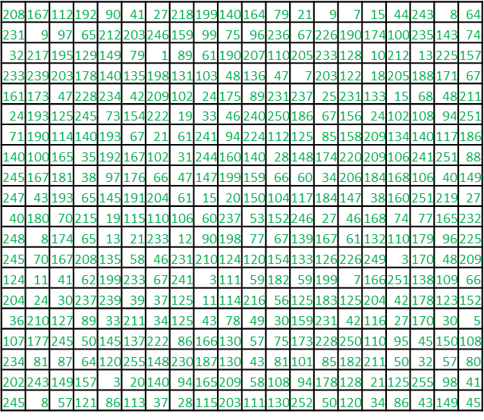
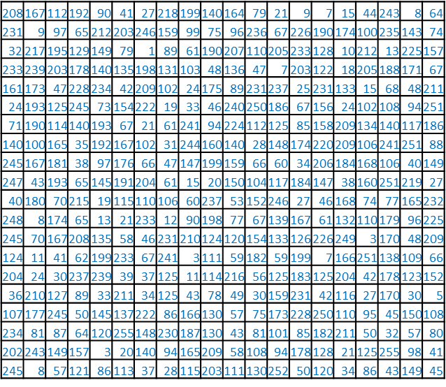
Grayscale
RGB Images
RGB

Slide 6
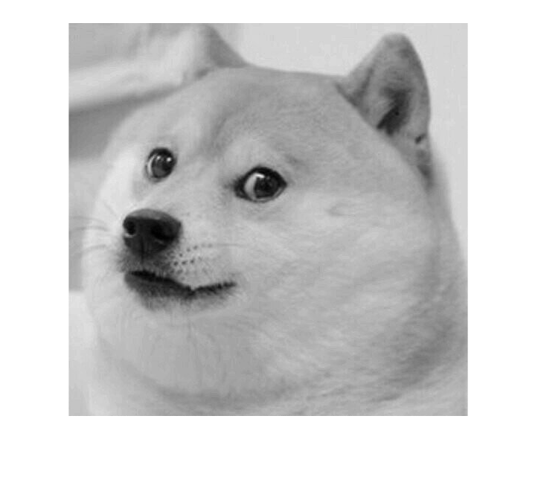
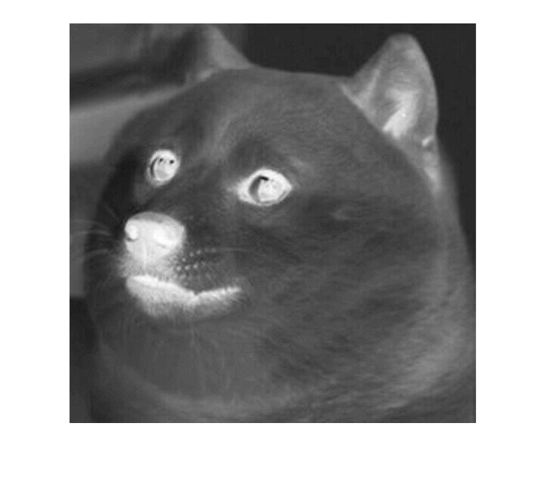
Prob. #1 – Gray doge
To run this, on command window
>> doge = imread('dogeBlank.jpeg‘)
>> dogeGray = rgb2gray(doge)
>> dogeFlip = uint8(255-dogeGray)

Slide 7
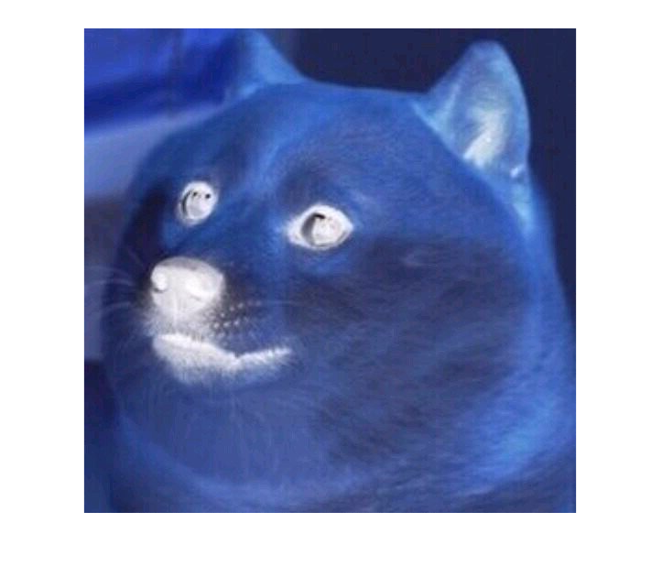
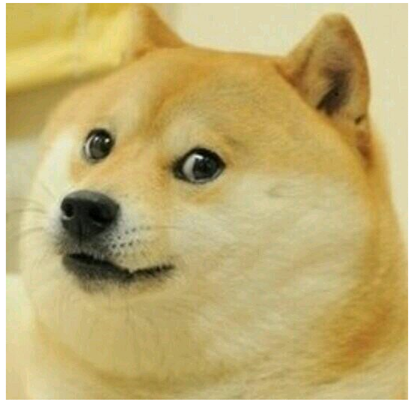
Prob. #2 – dogeNegative
On command window
>> dogeNegative = (225 – doge)

